Slide 1

503073
WEB PROGRAMMING & APPLICATIONS
LESSON 5: JAVASCRIPT
Instructor: Mai Van Manh

Slide 2
Outline
Basic Javascript
Document Object Model
Form Handling
Callback
Ajax
Web API

Slide 3
Javascipt Introduction

Slide 4
Introduction to Javascript
JavaScript is one of the most popular programming language.
JavaScript was initially created to “make web pages alive”.
When JavaScript was created, it initially had another name: “LiveScript”.
Javascript can be used for both front-end and back-end web development.

Slide 5
Javascript in client side
Add or remove HTML Elements.
Add or remove/change HTML Element attributes.
Change HTML Element content.
Change HTML Style.
Form validation.
Load data from server.
Post data to server.

Slide 6
Javascript in server side
Create a web server (like apache)
Access file system
Access OS features
Create a command line program
And more

Slide 7
Three ways to use Javascript in HTML
Inline Javasript
Internal Javascript
External Javascript

Slide 8
Inline Javascipt

Slide 9
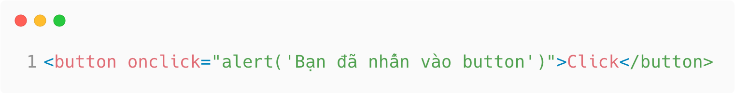
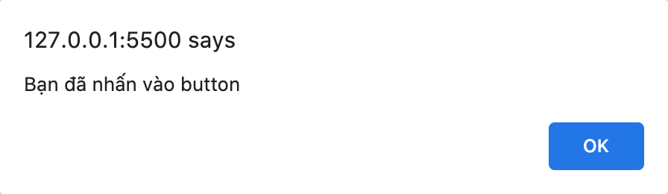
Inline Javascript
Javascript code can be written directly on an HTML element via the on[event] attributes such as: onclick, oninput, onfocus….

Slide 10
Internal Javascipt

Slide 11
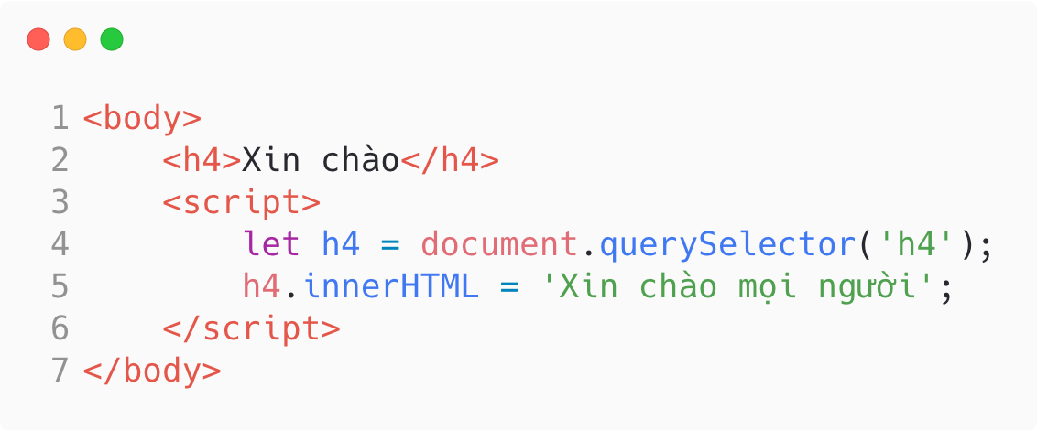
Inline Javascript
Internal javascript is the js code written inside the <script> tag, these tags are usually placed inside the <head> tag or before the </body> tag.

Slide 12
External Javascipt

Slide 13
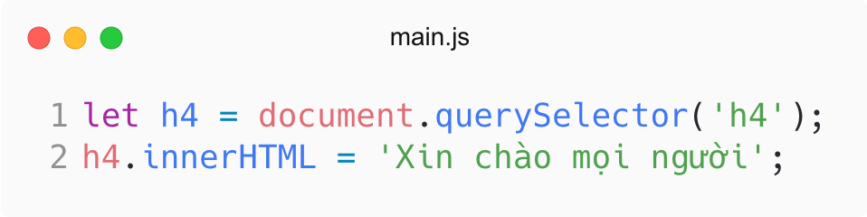
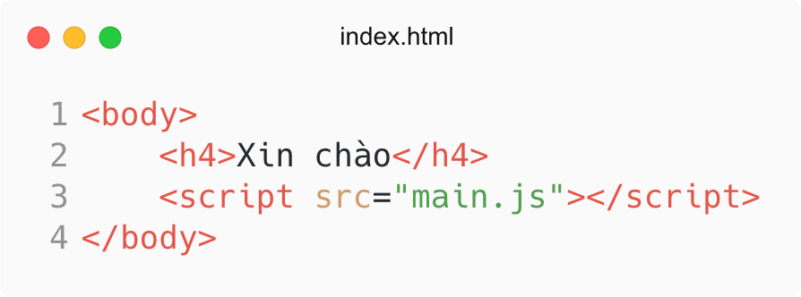
External Javascript
External javascript is js code written in a separate file with the extension *.js. This file is then referenced from HTML via the <script> tag.

Slide 14
Basic Syntax Examples

Slide 15
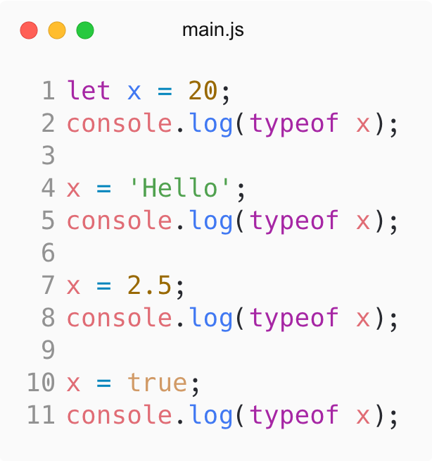
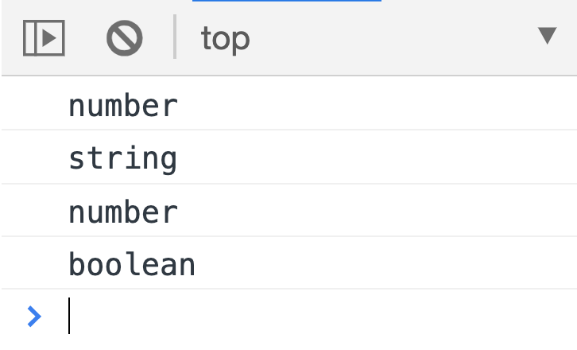
Data types
JavaScript variables can hold many data types: numbers, strings, objects and more.

Slide 16
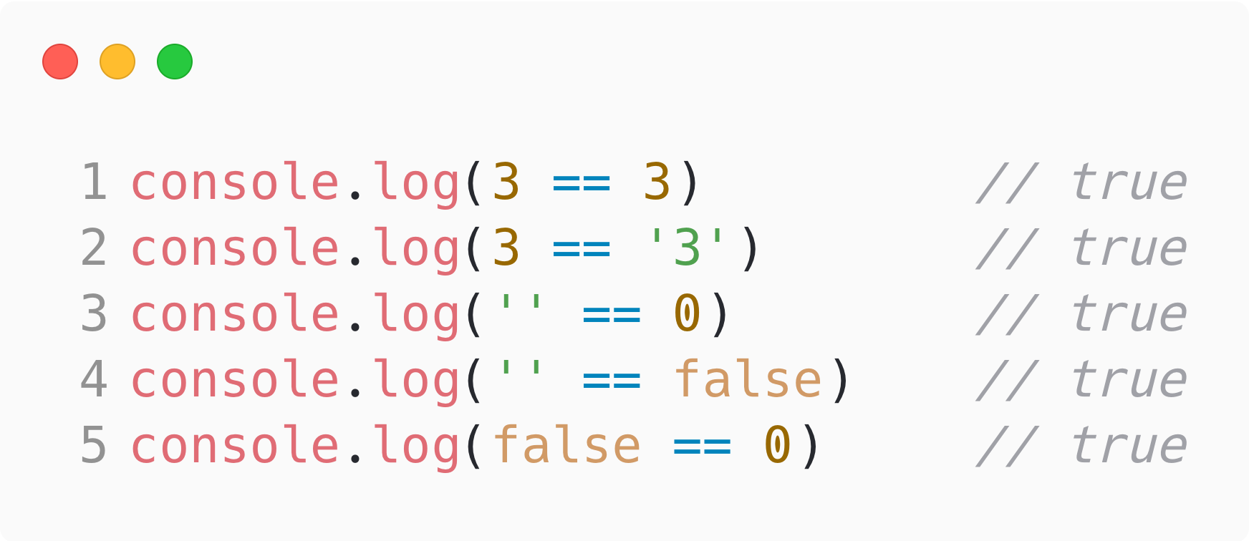
== vs ===

Slide 17
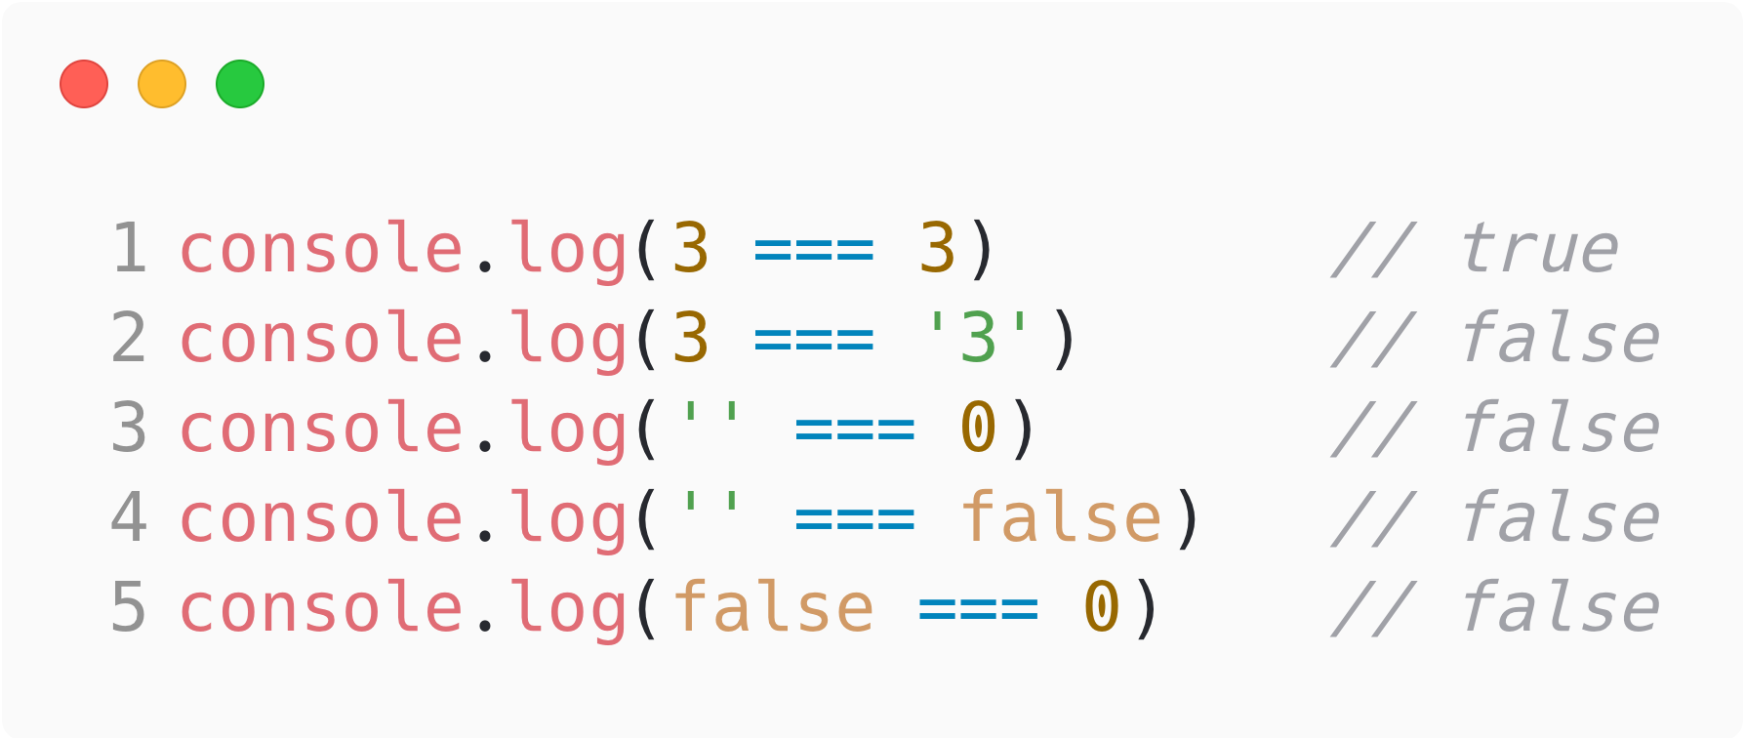
== vs ===

Slide 18
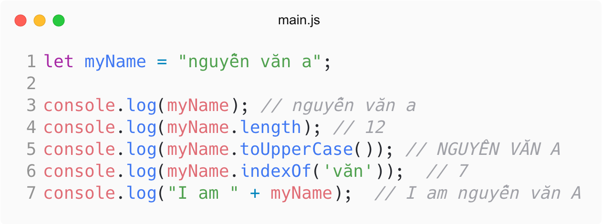
String

Slide 19
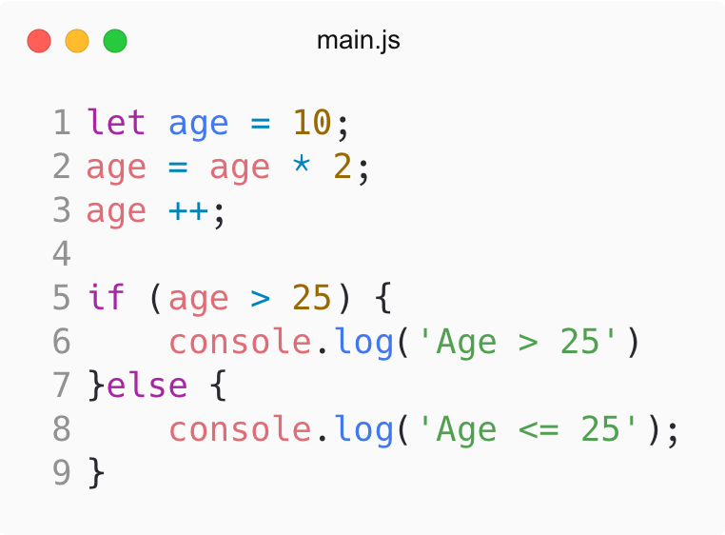
Variable and if-else statement

Slide 20
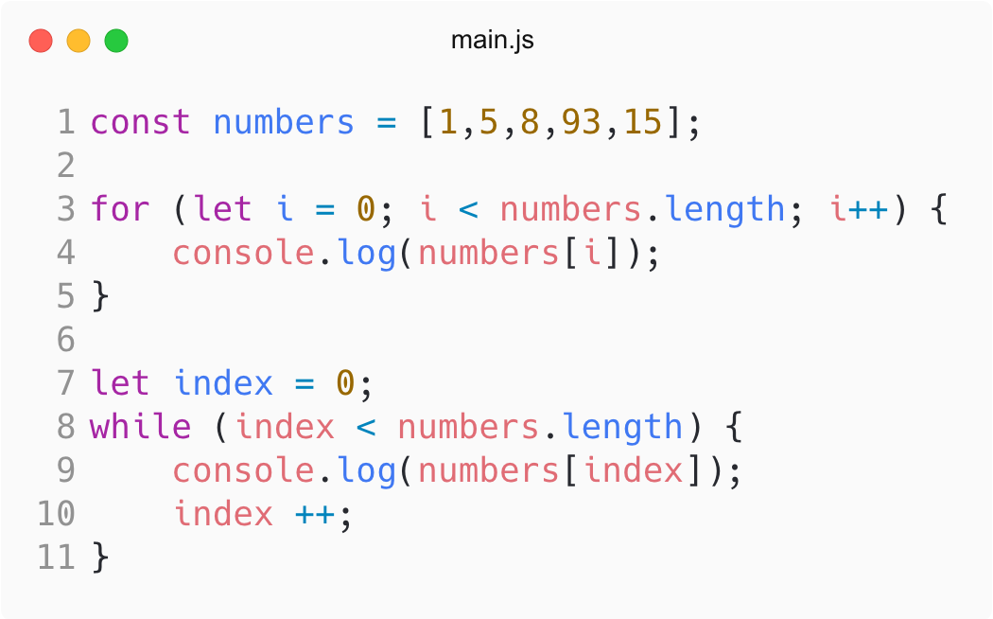
Constant and for/while loop

Slide 21
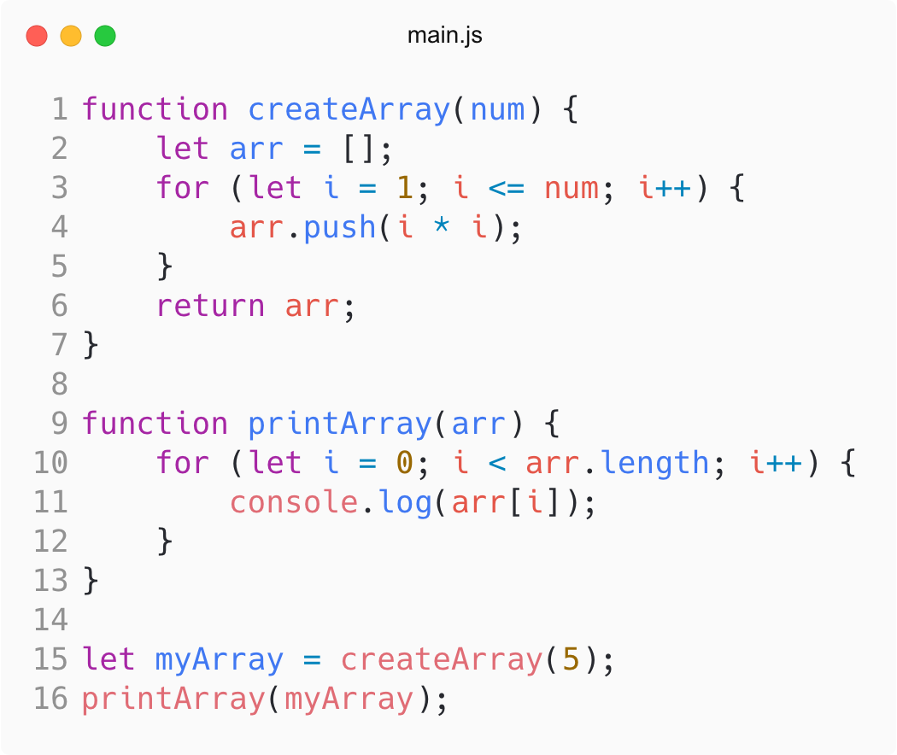
Function

Slide 22
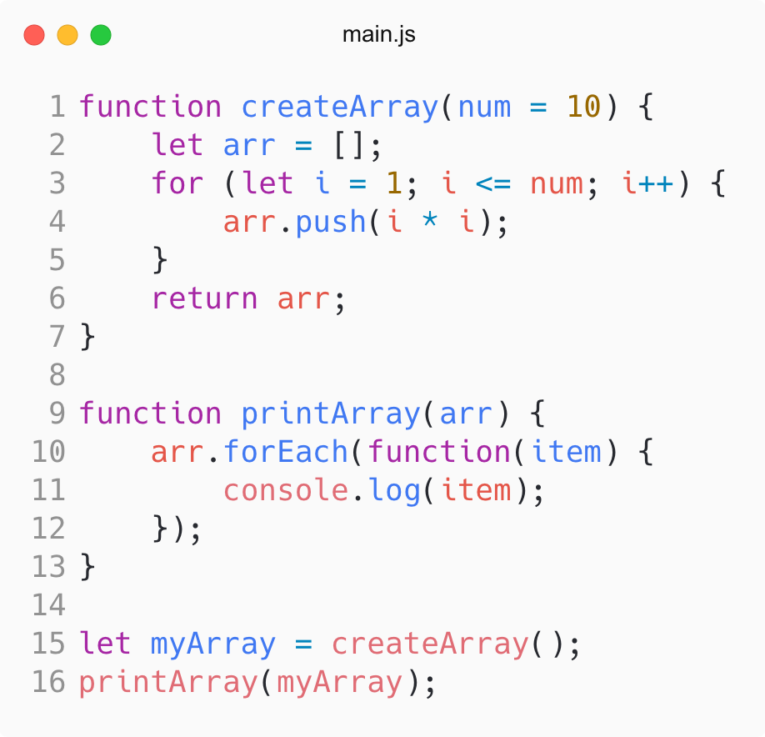

Slide 23
Callback Function

Slide 24
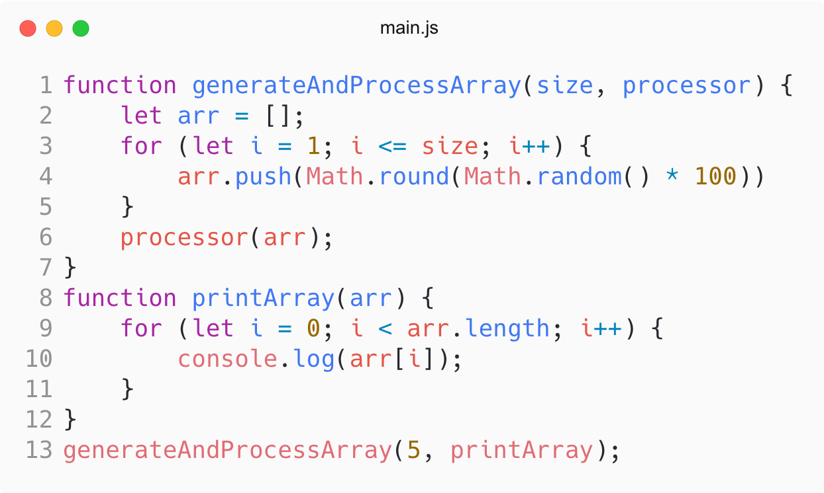
Callback function
A callback is a function passed as an argument to another function.

Slide 25
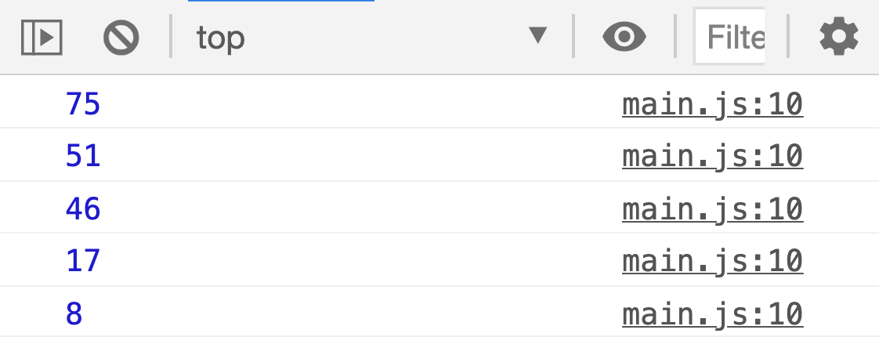
Callback function

Slide 26
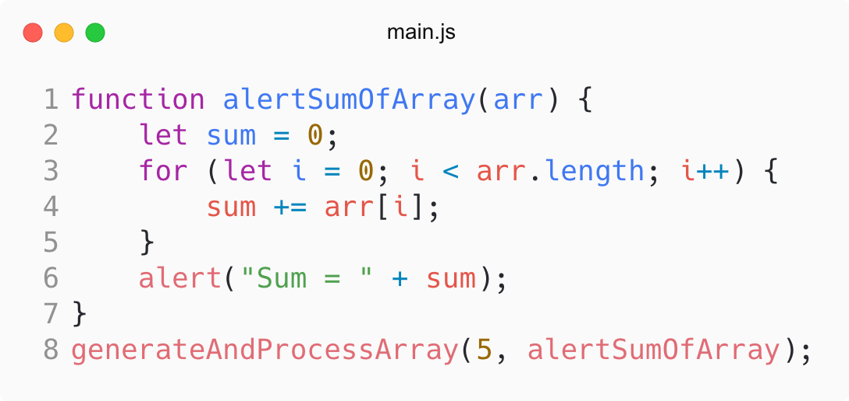
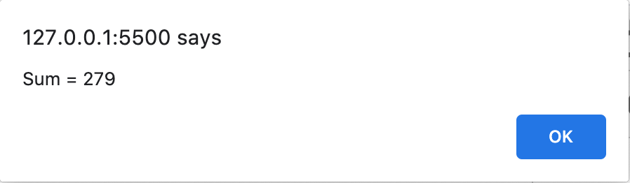
Callback function

Slide 27
Arrow function

Slide 28
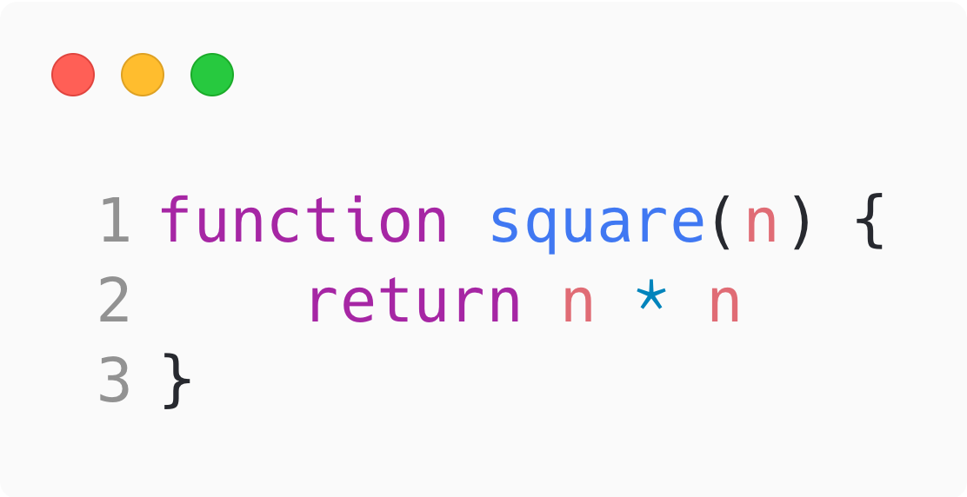
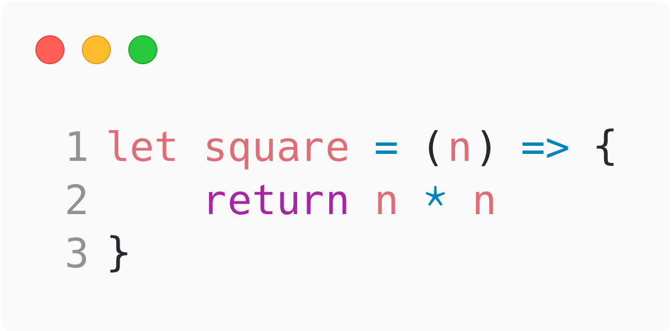
Arrow function
Arrow functions allow us to write shorter function syntax.

Slide 29
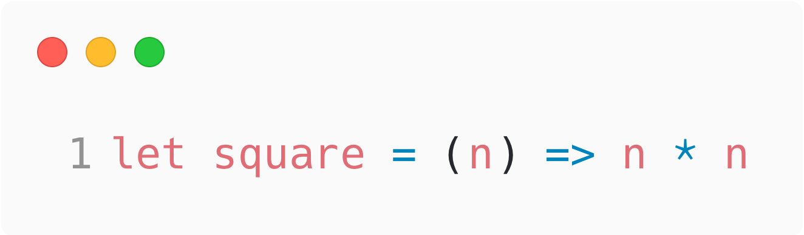
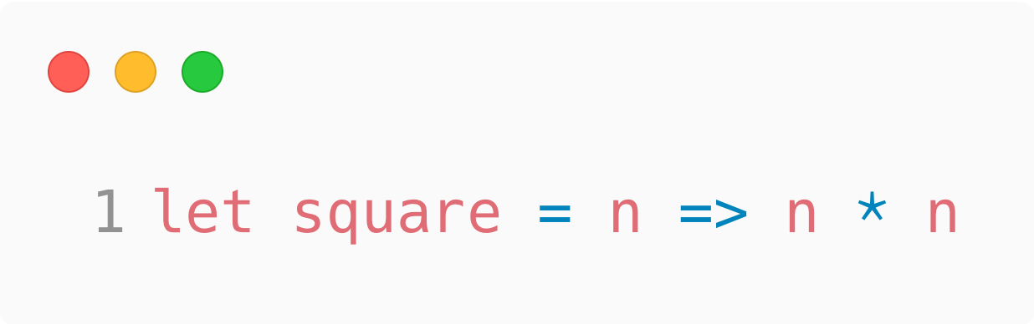
Arrow function
If the function has only one statement, and the statement returns a value, you can remove the brackets and the return keyword.

Slide 30
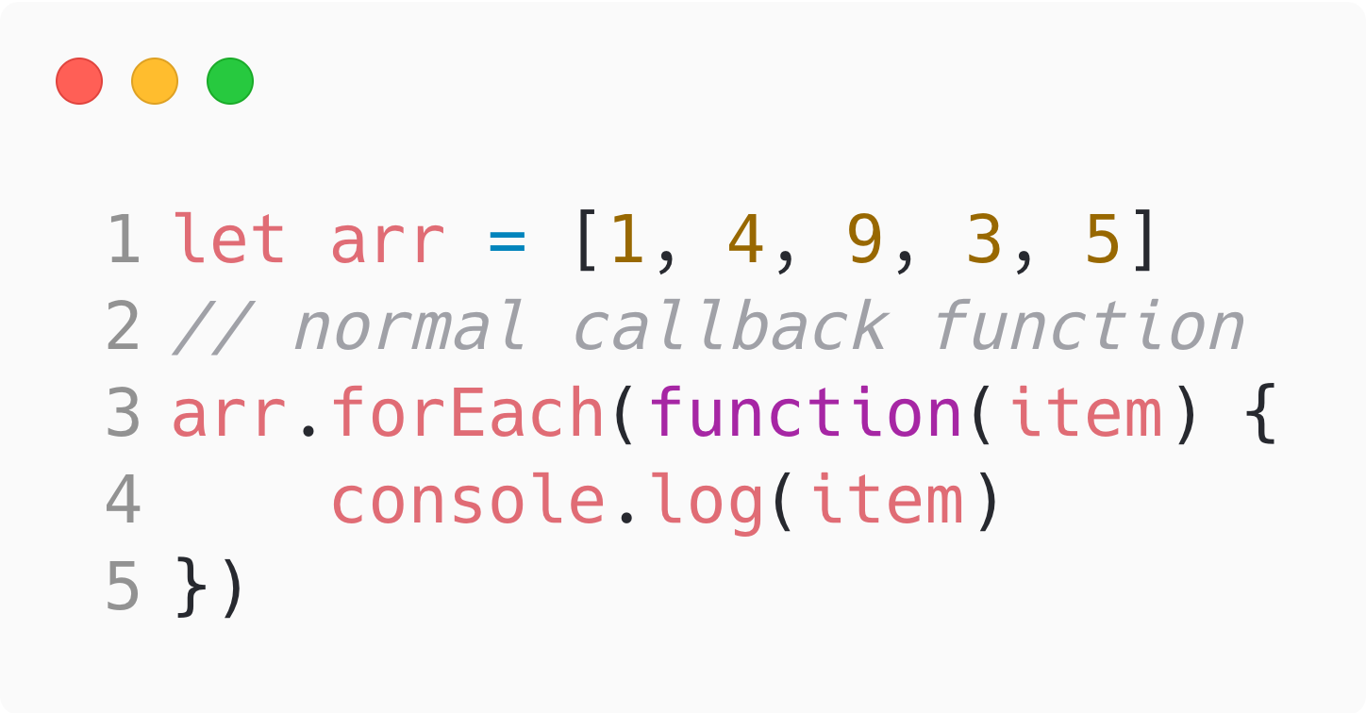
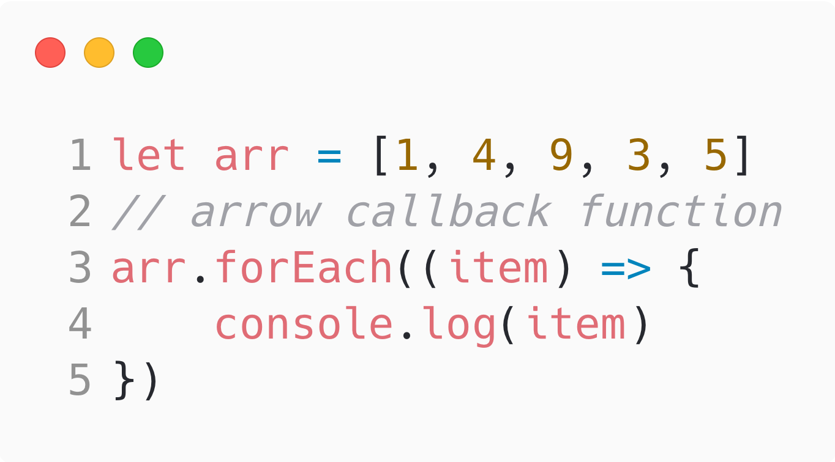
Arrow function as a callback

Slide 31
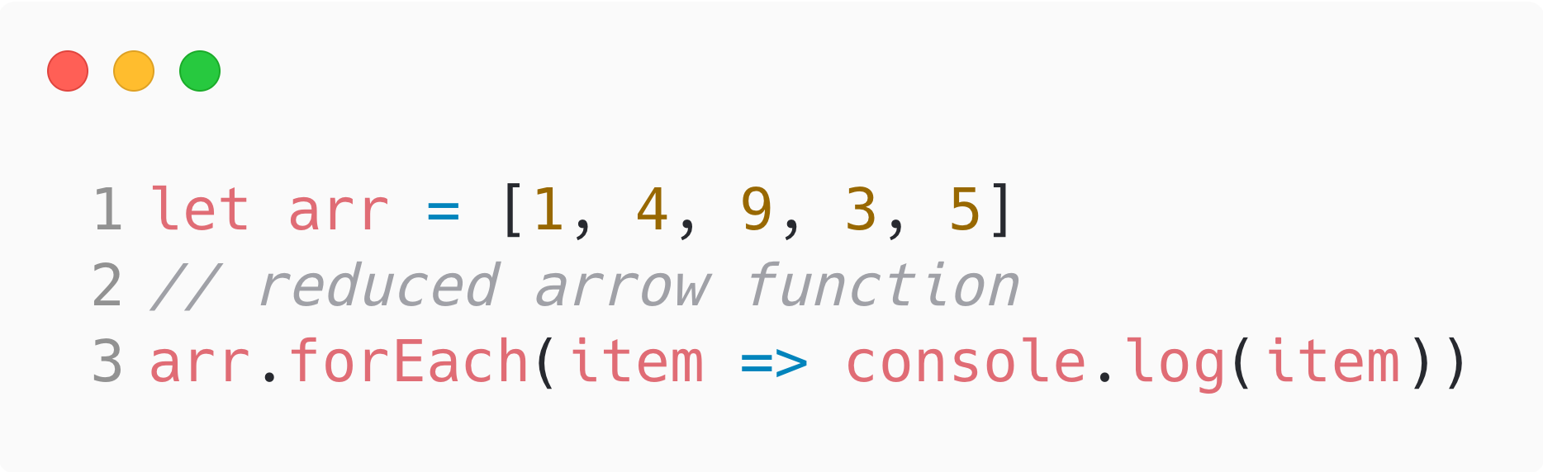
Reduced Arrow function

Slide 32
setTimeout

Slide 33
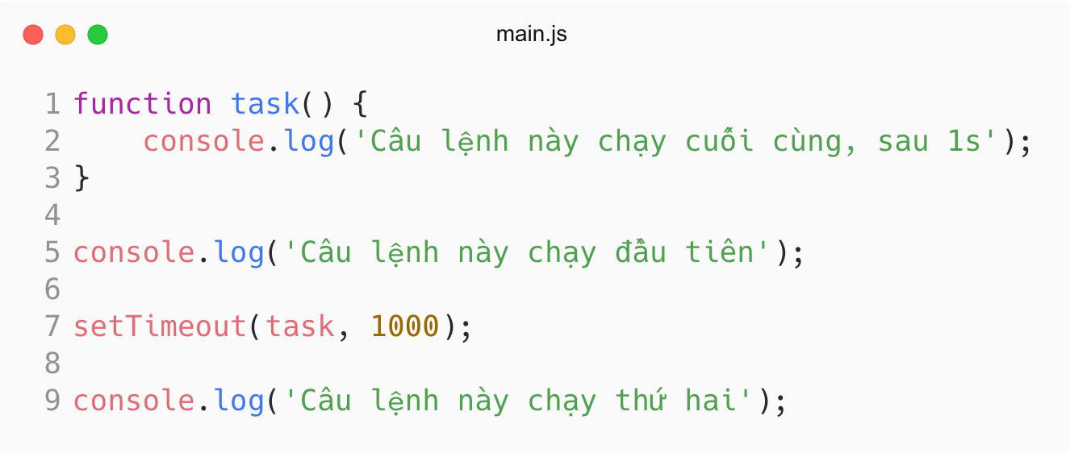
setTimeout
Executes a function, after waiting a specified number of milliseconds.
setTimeout(function, milliseconds);

Slide 34
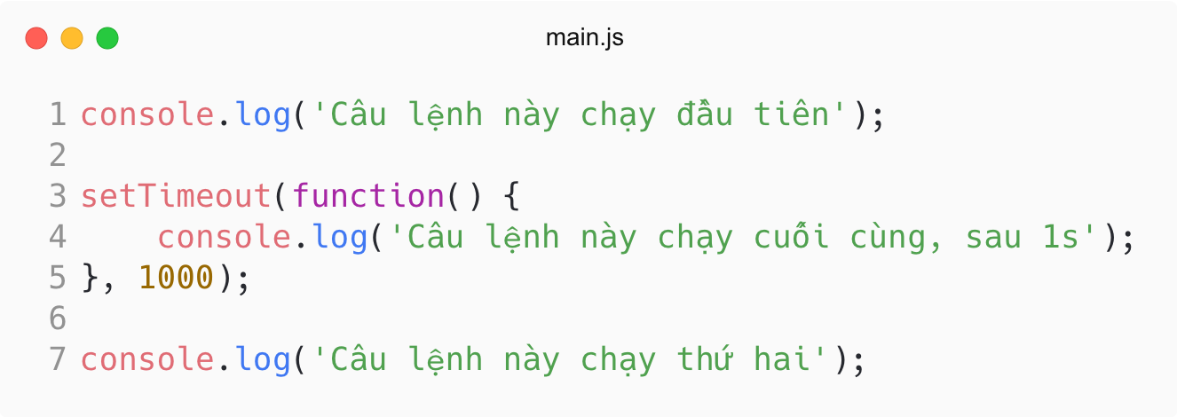
setTimeout v2

Slide 35
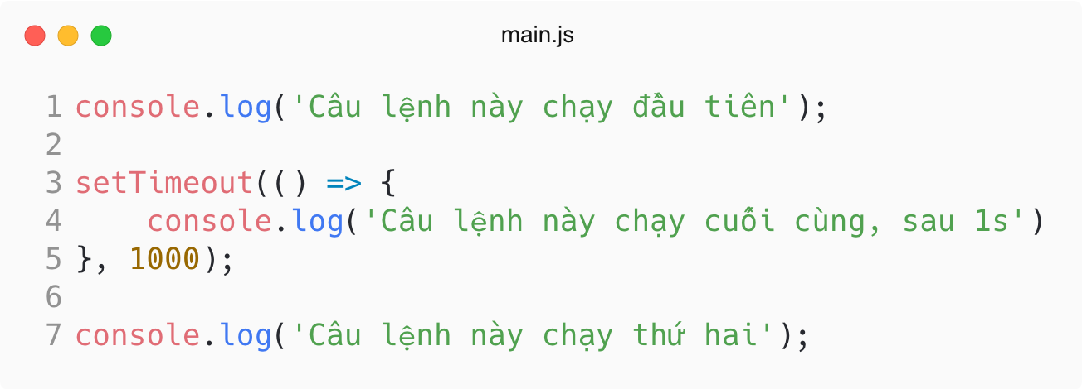
setTimeout v3

Slide 36
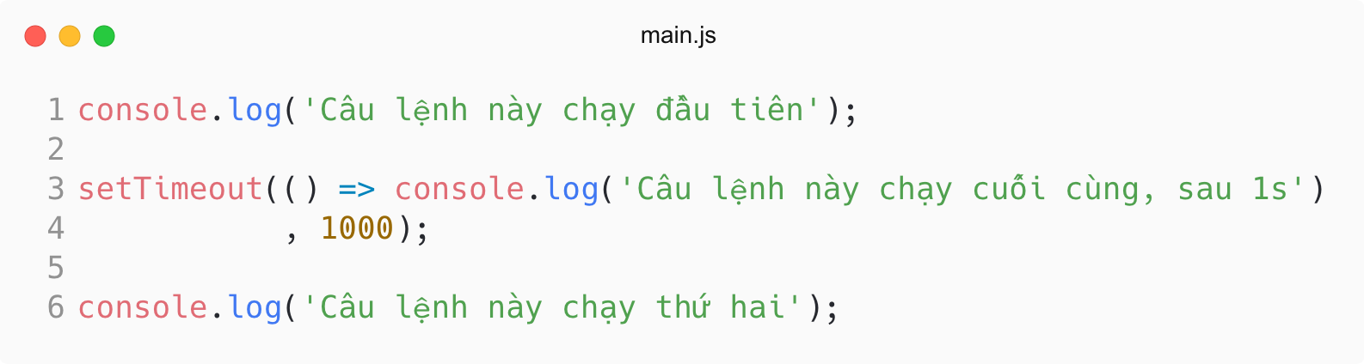
setTimeout v4

Slide 37
setInterval

Slide 38
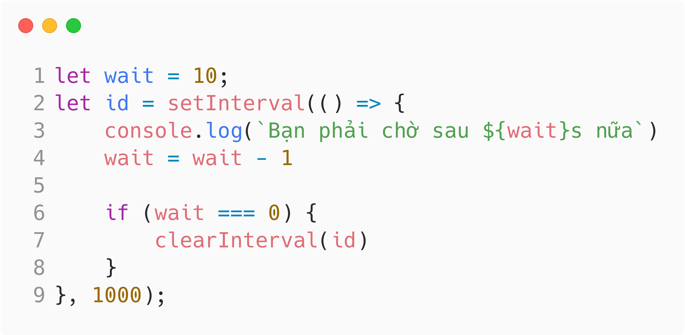
setInterval
The setInterval() method calls a function or evaluates an expression at specified intervals (in milliseconds).
setInterval(function, milliseconds);

Slide 39
Document Object Model

Slide 40
Document Object Model
The HTML DOM is a standard object model and programming interface for HTML. It defines:
The HTML elements as objects
The properties of all HTML elements
The methods to access all HTML elements
The events for all HTML elements

Slide 41
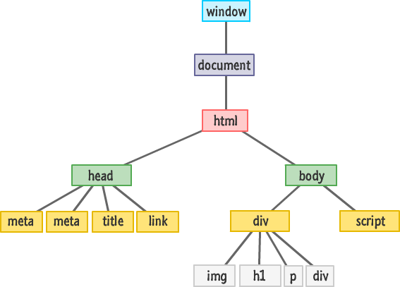

Slide 42
The HTML DOM is a standard for how to get, change, add, or delete HTML elements.

Slide 43
With the object model, JavaScript can:
change all the HTML elements
change all the HTML attributes
change all the CSS styles
remove HTML elements and attributes
add new HTML elements and attributes
react to all existing HTML events
create new HTML events

Slide 44
Finding HTML Elements

Slide 45
Finding HTML Elements
Finding HTML elements by id
Finding HTML elements by tag name
Finding HTML elements by class name
Finding HTML elements by CSS selectors
Finding HTML elements by HTML object collections

Slide 46
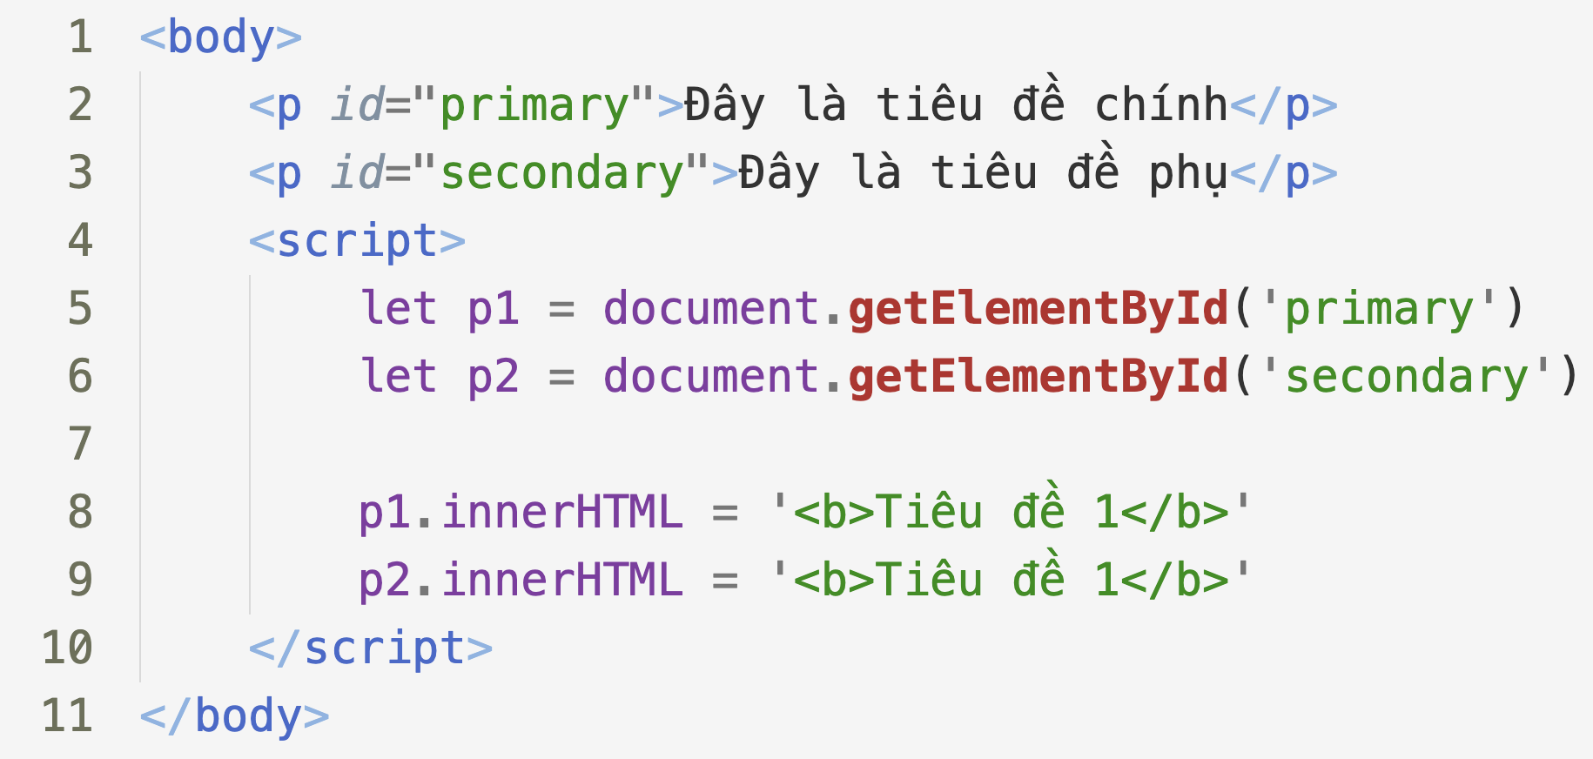
Find Element By Id

Slide 47
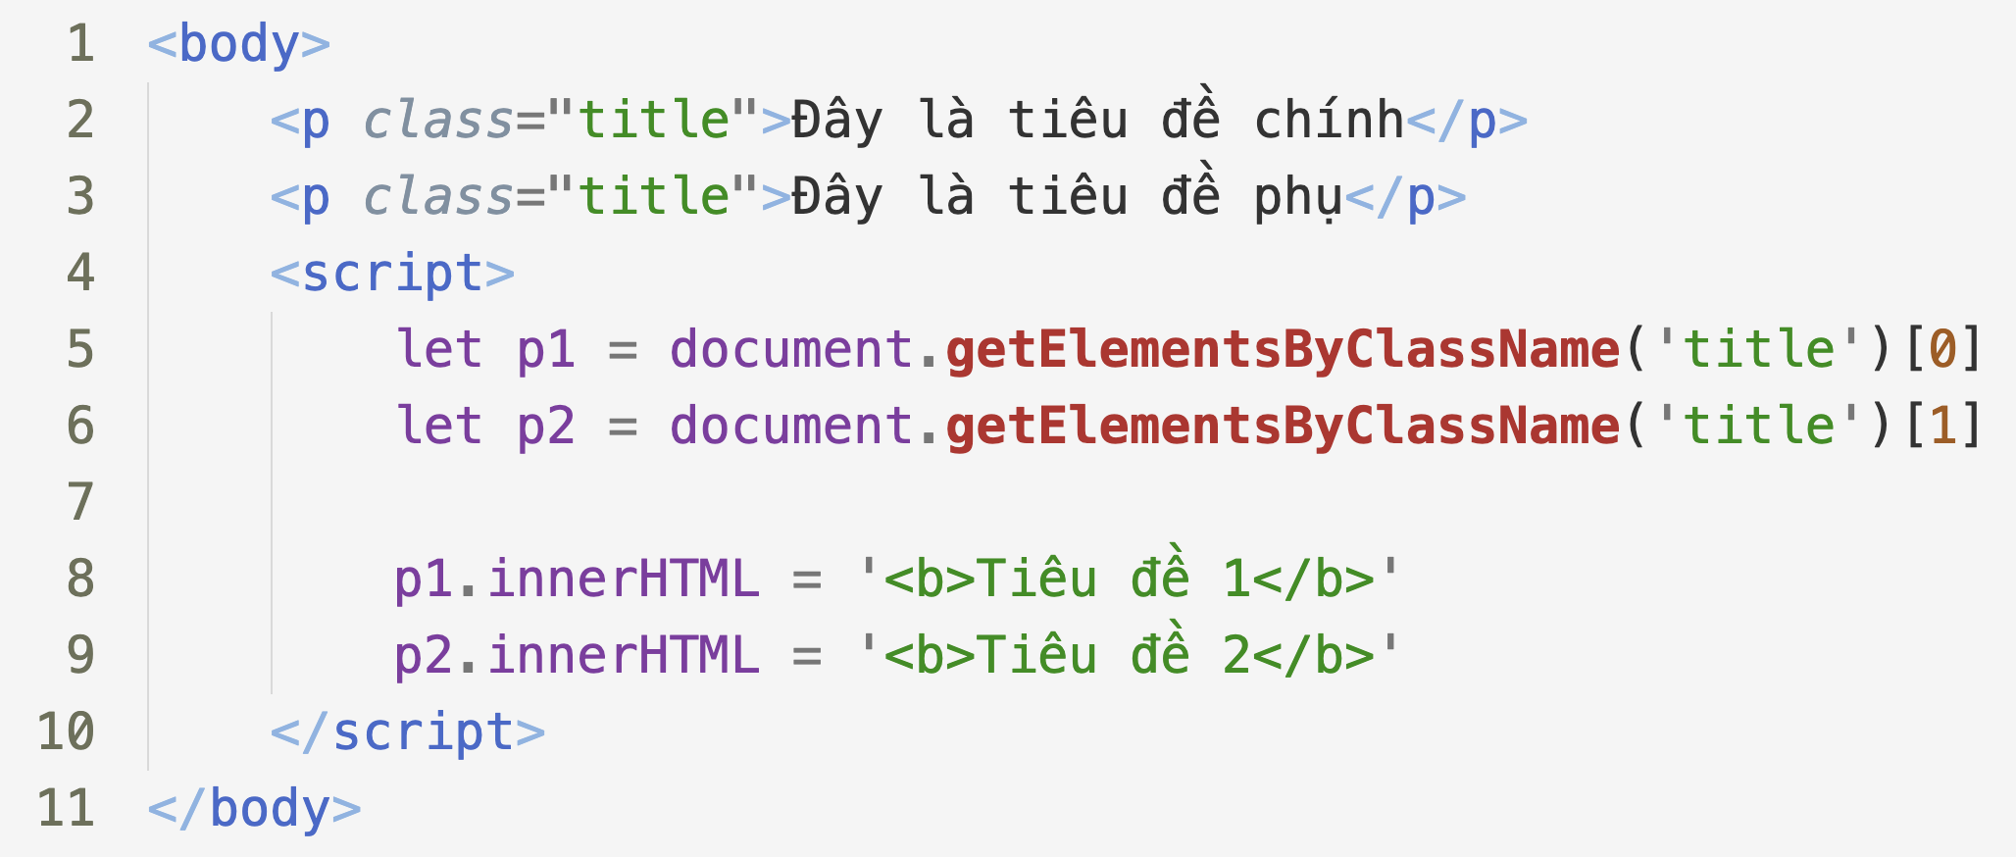
Find Element By Class Name

Slide 48
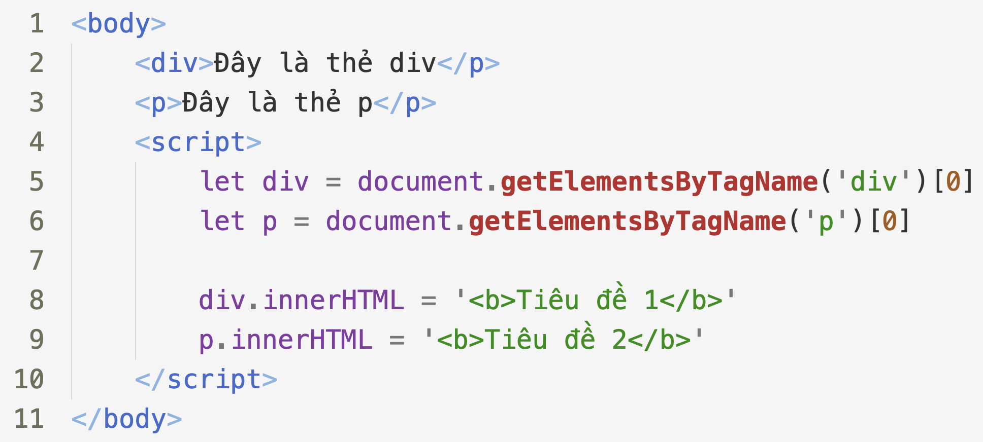
Find Element By Tag Name

Slide 49
Change Elements Attributes

Slide 50
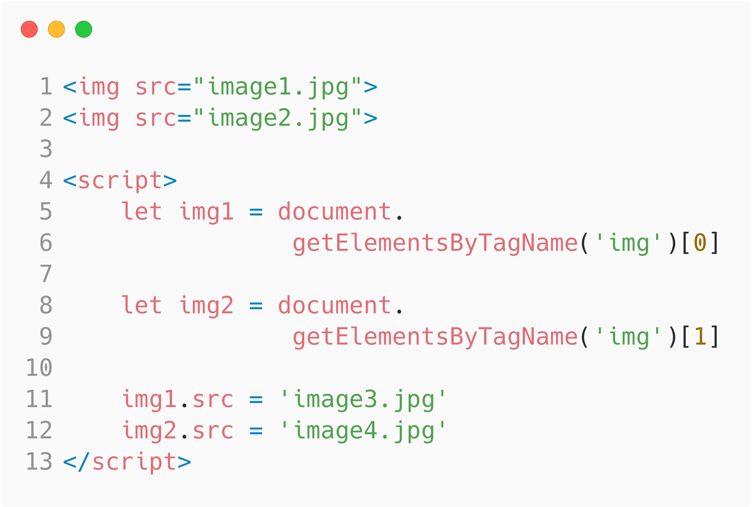
Change Image Source

Slide 51
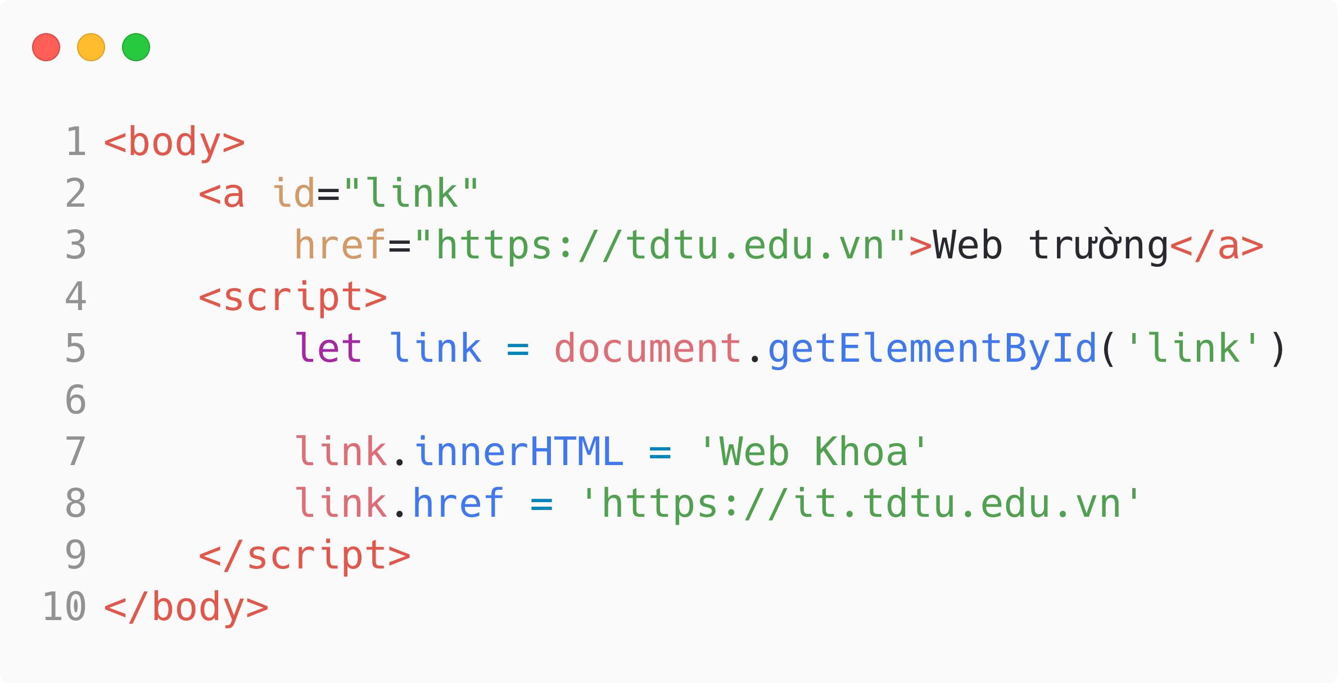
Change Link Source and Text

Slide 52
Change Elements Style

Slide 53
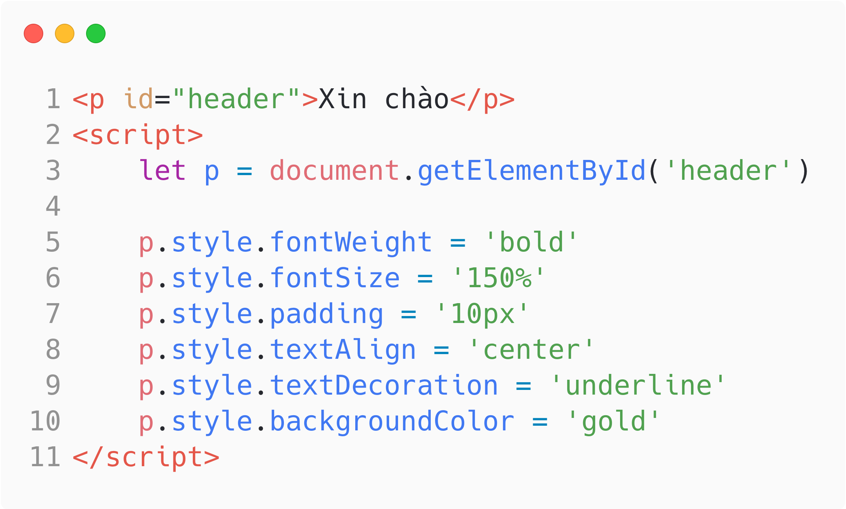
Change Text Style

Slide 54
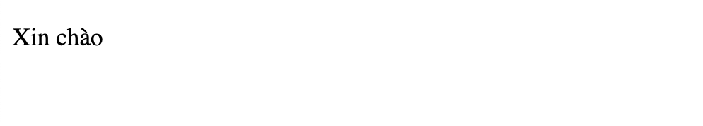

Change Text Style

